Slide 1
SECOND SUNDAY OF ADVENT
Year C
Malachi 3:1-4 - Luke 1:68-79 - Philippians 1:3-11 - Luke 3:1-6

Slide 2
See, I am sending my messenger to prepare the way before me … indeed, he is coming, says the LORD of hosts.
Malachi 3:1ac

Slide 3
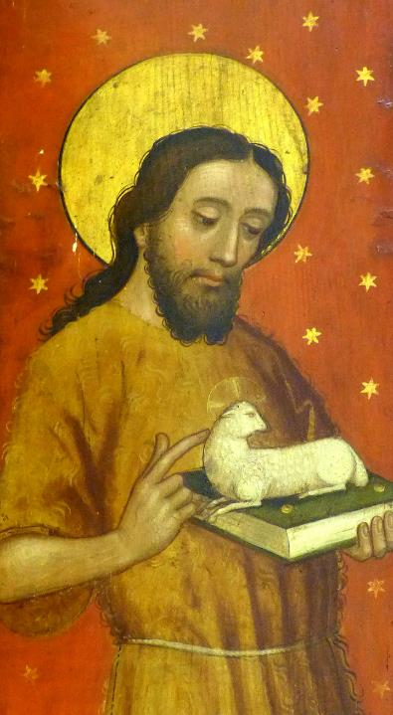
John the Baptist
Altar of St. Catherine
Church of St. John and St. Martin
Schwabach, Germany

Slide 4
"Blessed be the Lord God of Israel …
He has raised up a mighty savior for us in the house of his servant David,
Luke 1:68a, 69a

Slide 5
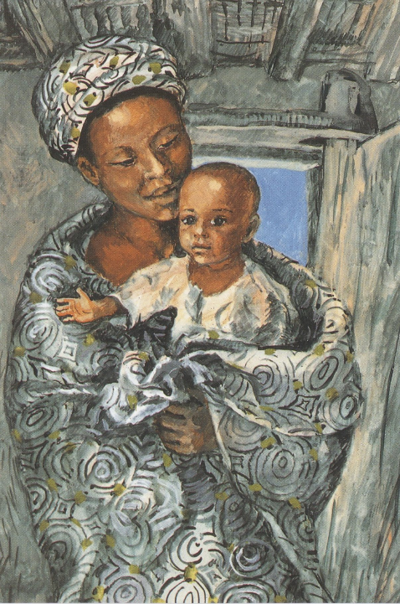
Mary and the Child Jesus
JESUS MAFA
Cameroon

Slide 6
And you, child, will be called the prophet of the Most High … to give knowledge of salvation to his people by the forgiveness of their sins.
Luke 1:76a, 77

Slide 7
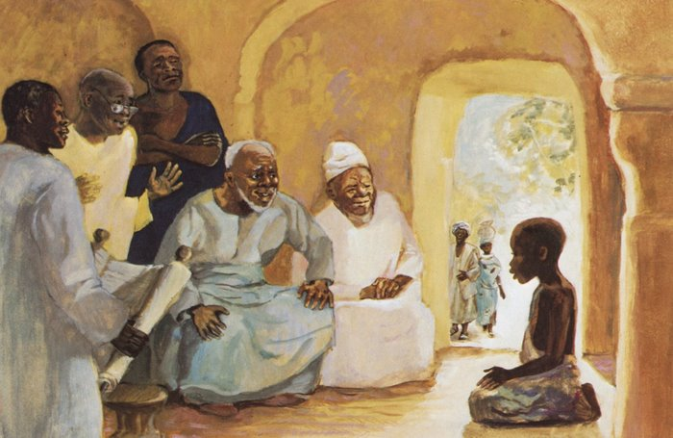
Christ Child Teaching in the Temple -- JESUS MAFA, Cameroon

Slide 8
By the tender mercy of our God, the dawn from on high will break upon us,
Luke 1:78

Slide 9
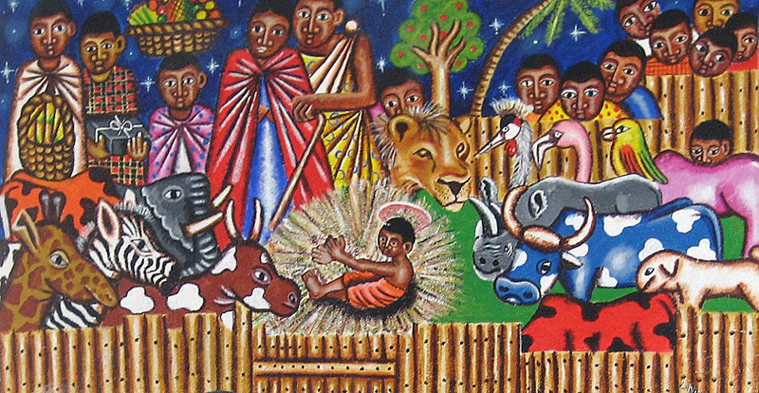
Kenyan Nativity, 2007

Slide 10
to give light to those who sit in darkness and in the shadow of death, to guide our feet into the way of peace."
Luke 1:79

Slide 11
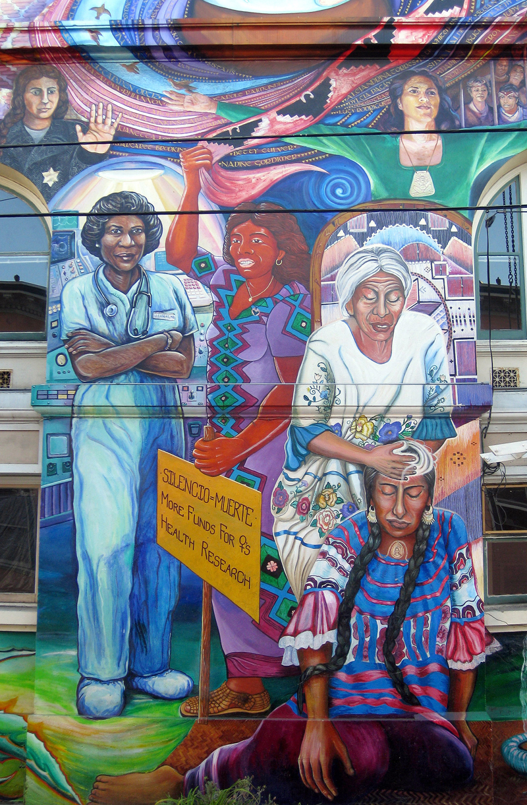
Maestra Peace Mural
Juana Alicia
Women's Building
San Francisco, CA

Slide 12
And this is my prayer, that your love may overflow … having produced the harvest of righteousness that comes through Jesus Christ …
Philippians 1:9a,11a

Slide 13
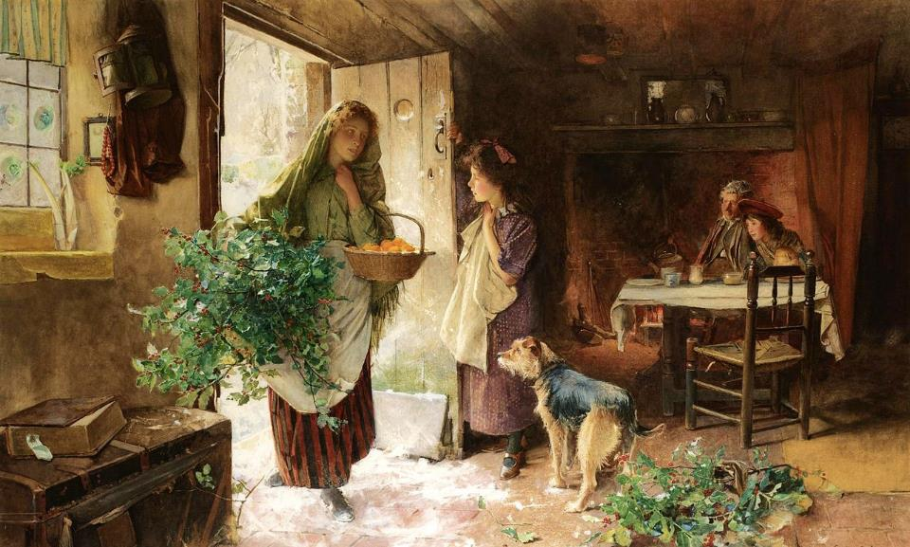
Christmas Eve -- Carlton Smith, 1901

Slide 14
… the word of God came to John son of Zechariah in the wilderness.
Luke 3:2

Slide 15
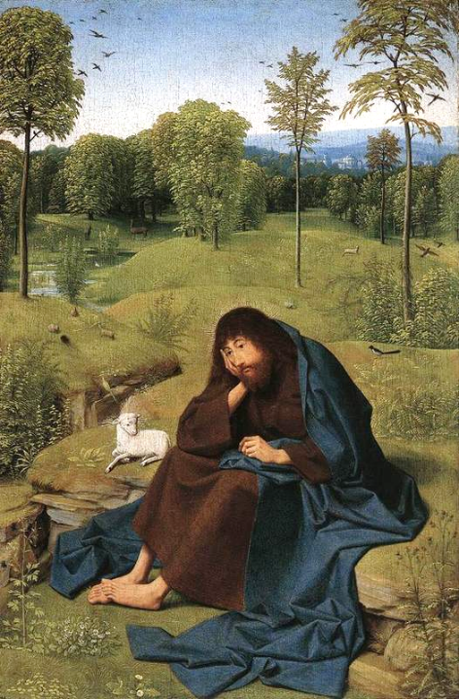
John the Baptist in the Wilderness
Geertgen tot Sint Jans
Gemaldegalerie
Berlin, Germany

Slide 16
He went into all the region around the Jordan, proclaiming a baptism of repentance for the forgiveness of sins,
Luke 3:3

Slide 17
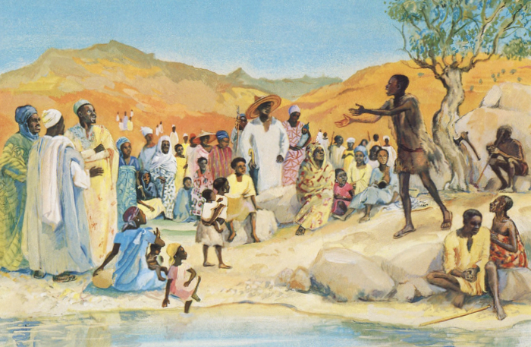
John the Baptist Preaching -- JESUS MAFA, Cameroon

Slide 18
as it is written …
"The voice of one crying out in the wilderness:
'Prepare the way of the Lord, make his paths straight.
Luke 3:4

Slide 19
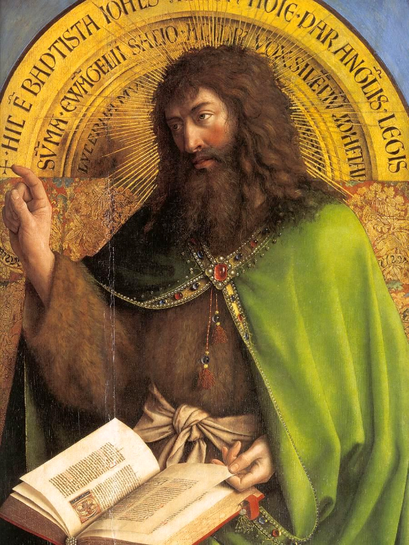
John the Baptist
Jan van Eyck
Ghent Altarpiece
St. Bavo Cathedral
Ghent, Belgium

Slide 20
Every valley shall be filled,
and every mountain and hill
shall be made low,
and the crooked shall be made straight,
and the rough ways made smooth;
Luke 3:5

Slide 21
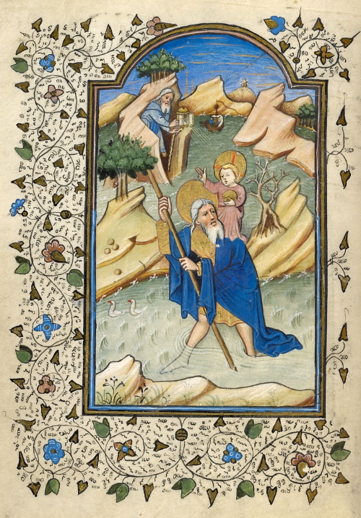
St. Christopher and the Christ Child on the Road of Life
Master of Guillebert de Mets
Morgan Library
New York, NY

Slide 22
and all flesh shall see the salvation of God.'"
Luke 3:6

Slide 23
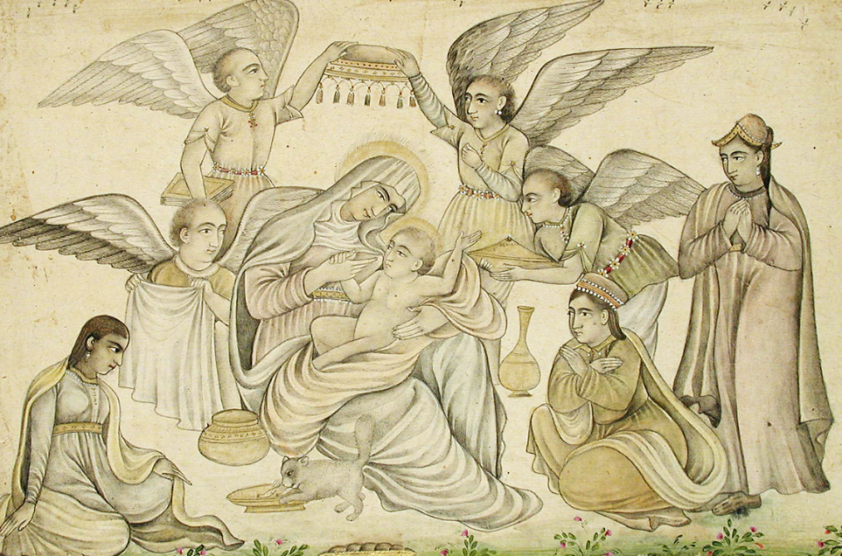
Angels Attend Mary and Jesus -- India, c. 1665, San Diego Museum of Art, San Diego, CA

Slide 24
Credits
New Revised Standard Version Bible, copyright 1989, Division of Christian Education of the National Council of the Churches of Christ in the United States of America. Used by permission. All rights reserved.
https://commons.wikimedia.org/wiki/File:Schwabach_Stadtkirche_-_Katharinenaltar_Fl%C3%BCgel_4a.jpg
Éditions de l’Emmanuel, https://www.editions-emmanuel.com/contact/
http://diglib.library.vanderbilt.edu/act-imagelink.pl?RC=48280
https://www.flickr.com/photos/genvessel/537858093 - klndonnelly
https://www.flickr.com/photos/wallyg/3922802370
https://commons.wikimedia.org/wiki/File:Carlton_Alfred_Smith_-_Christmas_Eve.jpg
https://commons.wikimedia.org/wiki/File:Geertgen_tot_Sint_Jans_-_John_the_Baptist_in_the_Wilderness_-_WGA08515.jpg
http://diglib.library.vanderbilt.edu/act-imagelink.pl?RC=48386
https://commons.wikimedia.org/wiki/File:Jan_van_Eyck_-_The_Ghent_Altarpiece_-_St_John_the_Baptist_(detail)_-_WGA07634.jpg
https://commons.wikimedia.org/wiki/File:St-Chrisopher-Christ-Child-Ghent-1420-Book-Hours-Master-of-Guillebert-de-Mets.png
https://www.flickr.com/photos/asianartsandiego/4837637537
Additional descriptions can be found at the Art in the Christian Tradition image library, a service of the Vanderbilt Divinity Library, http://diglib.library.vanderbilt.edu/. All images available via Creative Commons 3.0 License.

