Slide 1
Fifth Sunday after Pentecost
2 Samuel 1:1, 17-27 and Psalm 130 Wisdom of Solomon 1:13-15, 2:23-24 or Lamentations 3:22-33 and Psalm 30
2 Corinthians 8:7-15 Mark 5:21-43
Year B

Slide 2
Saul and Jonathan … they were swifter than eagles, they were stronger than lions. How the mighty have fallen!
2 Samuel 1:23ac, 19b

Slide 3
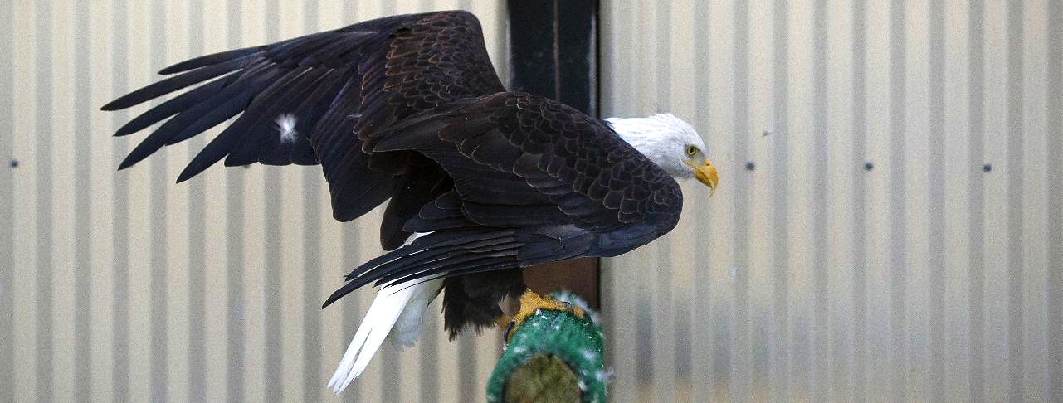
Rescued, Disabled Eagle -- Memorial Park, Joint Base Elmendorf-Richardson, Alaska

Slide 4
The steadfast love of the Lord never ceases, his mercies never come to an end; they are new every morning; great is your faithfulness.
Lamentations 3:22-23

Slide 5
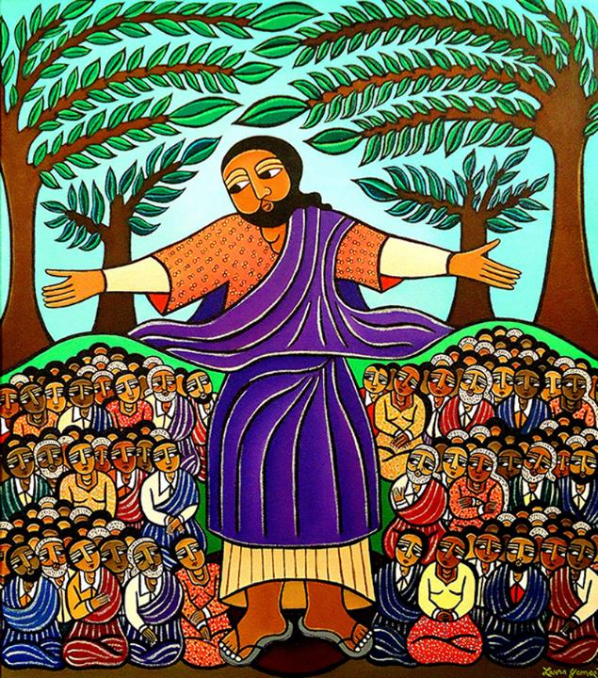
Sermon on the Mount
Laura James
New York, NY

Slide 6
You have turned my mourning into dancing; you have taken off my sackcloth and clothed me with joy …
Psalm 30:11

Slide 7
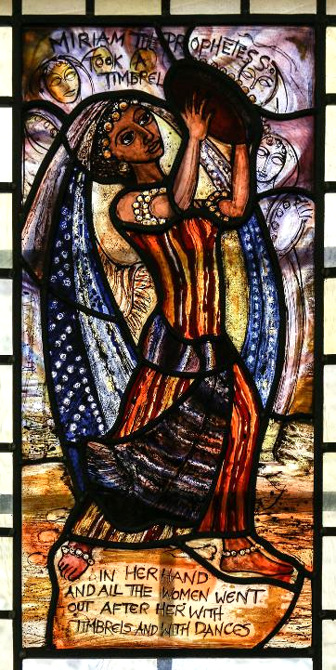
Song of Miriam
Pippa Blackall
St Edmondsbury, UK

Slide 8
I do not mean that there should be relief for others and pressure on you, but it is a question of a fair balance between your present abundance and their need …
2 Corinthians 8:13-14

Slide 9
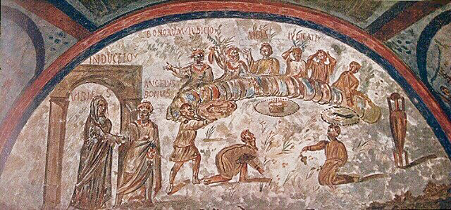
Agape Meal -- 3rd century, Catacomb of Domitilla, Rome, Italy

Slide 10
Then one of the leaders of the synagogue named Jairus … begged him … "My little daughter is at the point of death. Come and lay your hands on her … "
Mark 5:22a, 23b

Slide 11
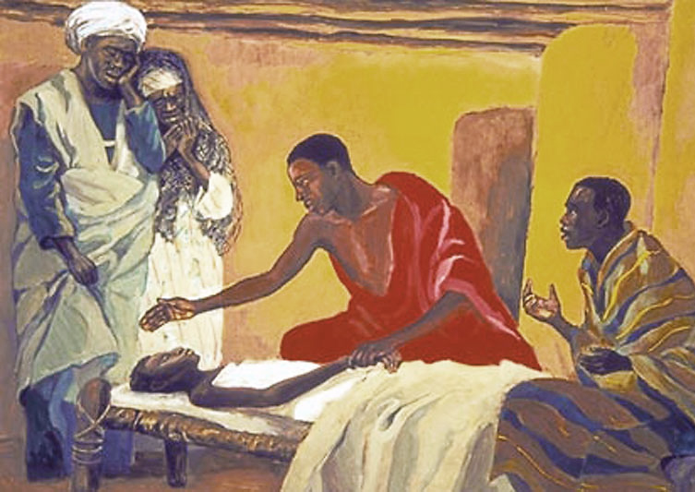
Healing of the Daughter of Jairus -- JESUS MAFA

Slide 12
… he said to them, "Why do you make a commotion and weep?
The child is not dead but sleeping."
Mark 5:38a, 39b

Slide 13
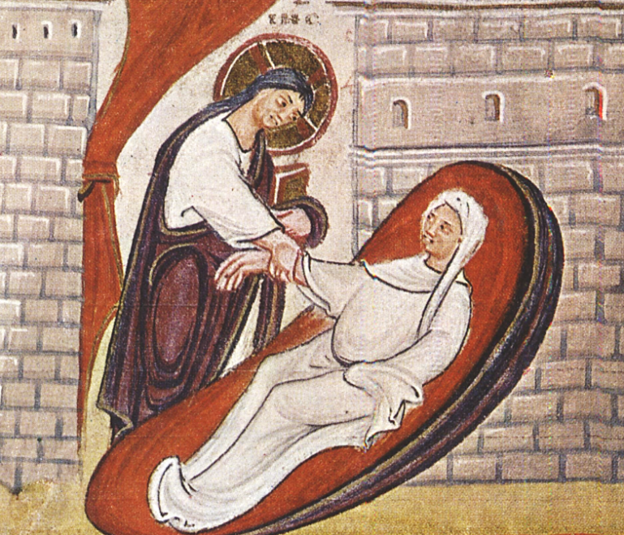
Christ Raising the Daughter of Jairus -- Codex Egberti, 10th c., Stadtbibliotheque, Trier, Germany

Slide 14
He took her by the hand and said to her, "Talitha cum," which means, "Little girl, get up!"
Mark 5:41

Slide 15
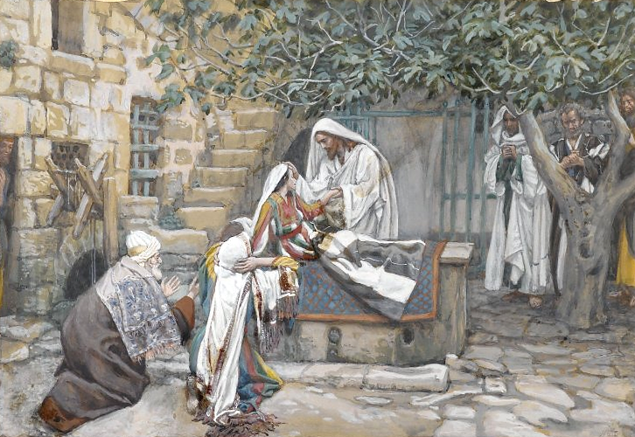
The Daughter of Jairus -- James Tissot, Brooklyn Museum, New York, NY

Slide 16
And immediately the girl got up and began to walk about …
Mark 5:42a

Slide 17
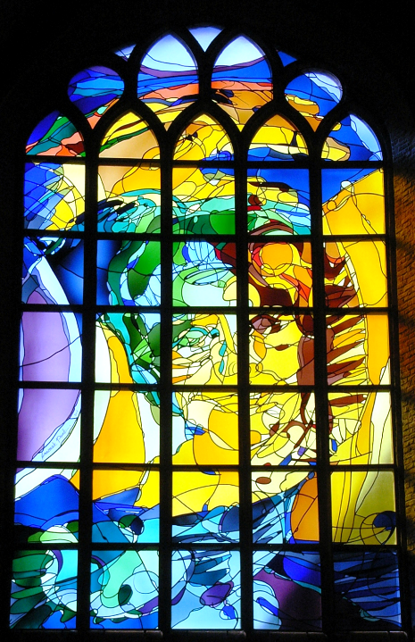
Jairus' Daughter
Annemiek Punt
Nieuwe Kerk
Delft, Netherlands

Slide 18
Now there was a woman who had been suffering from hemorrhages for twelve years.
Mark 5:25

Slide 19
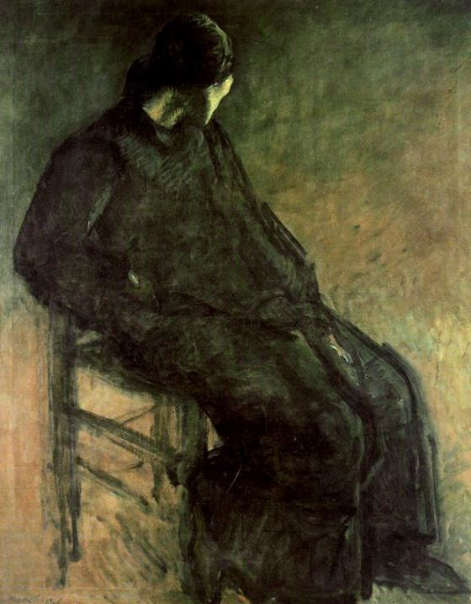
La Viuda
Isidre Nonell
Barcelona, Spain

Slide 20
She had heard about Jesus, and came up behind him in the crowd and touched his cloak, for she said, "If I but touch his clothes, I will be made well."
Mark 5:27-28

Slide 21
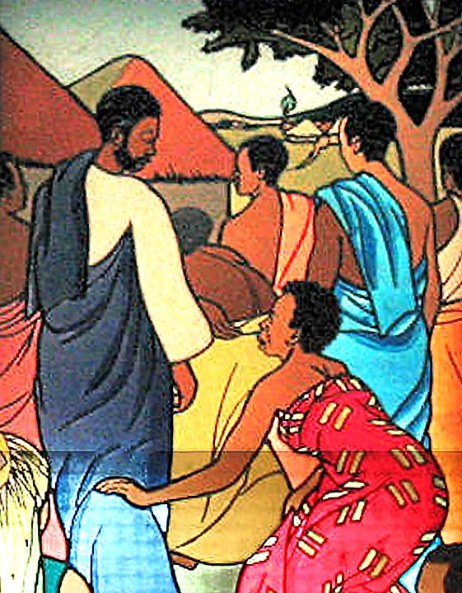
The Woman Who Touched the Cloak of Jesus
Mulungwishi Stained Glass Windows
DRCongo

Slide 22
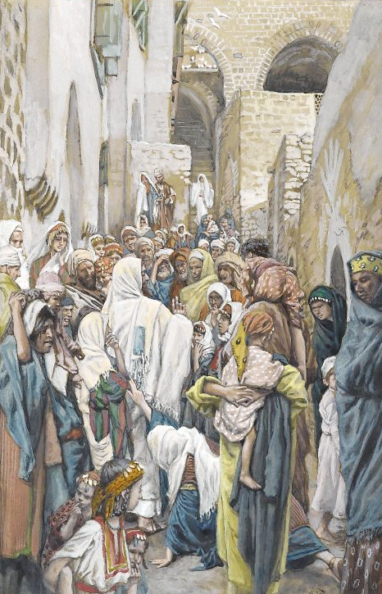
Christ and the Woman with the Issue of Blood
James Tissot
Brooklyn Museum
New York, NY

Slide 23
Immediately her hemorrhage stopped; aware that power had gone forth from him, Jesus turned about in the crowd and said, "Who touched my clothes?"
Mark 5:29a, 30b

Slide 24
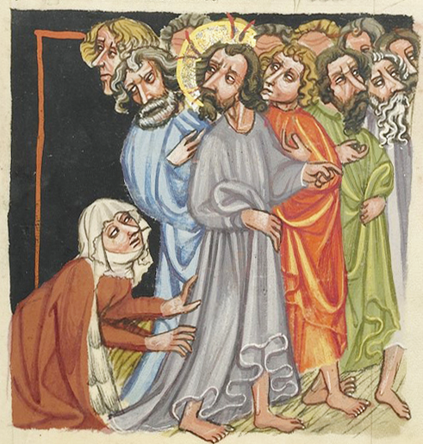
Healing of the Woman with an Issue of Blood
15th c. manuscript
Getty Open Content Program

Slide 25
... the woman, knowing what had happened to her, came in fear and trembling … He said to her, "Daughter, your faith has made you well; go in peace … "
Mark 5:33b, 34a

Slide 26
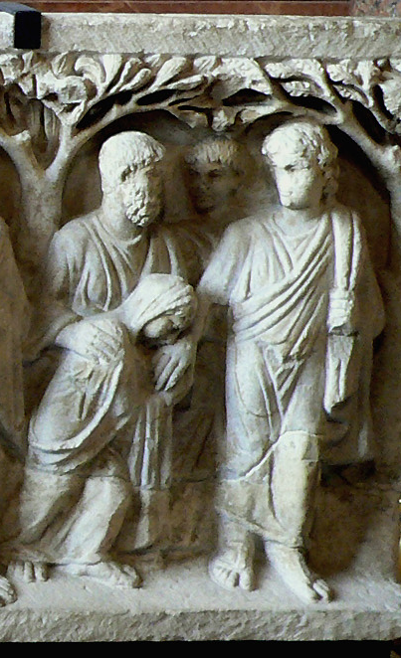
Christ and the Woman with an Issue of Blood
Louvre Museum
Paris, France

Slide 27
Credits
New Revised Standard Version Bible, copyright 1989, Division of Christian Education of the National Council of the Churches of Christ in the United States of America. Used by permission. All rights reserved.
https://commons.wikimedia.org/wiki/File:Eagle_nests_at_Memorial_to_fallen_Airmen_141006-F-LX370-063.jpg
https://www.laurajamesart.com/collections/religious/
https://www.flickr.com/photos/paullew/33172410852
http://diglib.library.vanderbilt.edu/act-imagelink.pl?RC=49628
http://diglib.library.vanderbilt.edu/act-imagelink.pl?RC=56455
https://commons.wikimedia.org/wiki/File:CodexEgberti-Fol025-RessurectionOfJairusDaughter.jpg
https://commons.wikimedia.org/wiki/File:Brooklyn_Museum_-_The_Daughter_of_Jairus_(La_fille_de_Z%C3%A4ire)_-_James_Tissot_-_overall.jpg
https://commons.wikimedia.org/wiki/File:Delft_NKerk_Jairus.JPG
http://commons.wikimedia.org/wiki/File:Nonel_La_Viuda.jpg
https://www.flickr.com/photos/umccongo/2188556416
https://commons.wikimedia.org/wiki/File:Brooklyn_Museum_-_The_Woman_with_an_Issue_of_Blood_(L%27h%C3%A9moro%C3%AFsse)_-_James_Tissot.jpg
Digital image courtesy of the Getty's Open Content Program. http://www.getty.edu/art/collection/objects/2048/unknown-maker-the-healing-of-a-woman-with-an-issue-of-blood-german-about-1400-1410/
https://commons.wikimedia.org/wiki/File:Sarcophage_%C3%A0_arbres,_Louvre_00.JPG
Additional descriptions can be found at the Art in the Christian Tradition image library, a service of the Vanderbilt Divinity Library, http://diglib.library.vanderbilt.edu/. All images available via Creative Commons 3.0 License.

