Slide 1
Fourteenth Sunday after Pentecost
Year B
Song of Solomon 2:8-13 and Psalm 45:1-2, 6-9 Deuteronomy 4:1-2, 6-9 and Psalm 15 • James 1:17-27 Mark 7:1-8, 14-15, 21-23

Slide 2
The voice of my beloved! Look, he comes, leaping upon the mountains, bounding over the hills.
Song of Solomon 2:8

Slide 3
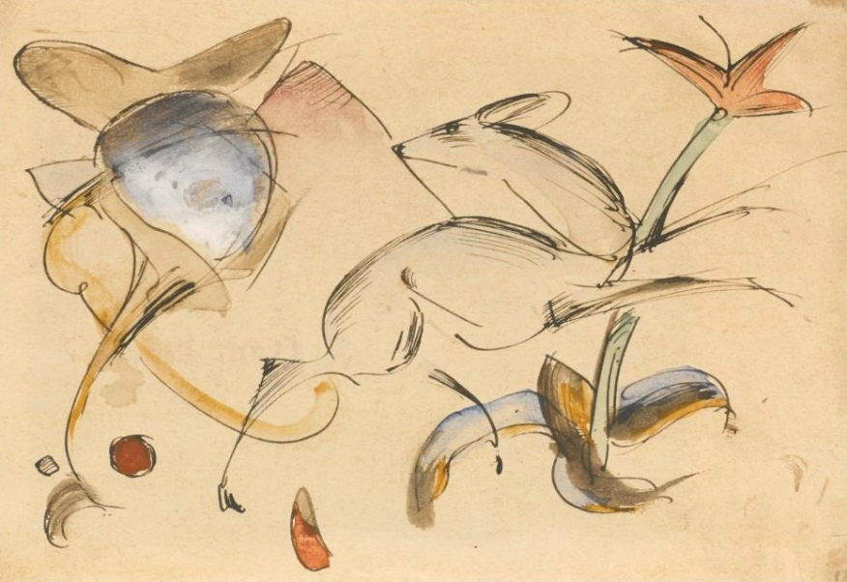
Deer Leaping Among Flowers – Franz Marc, 1912

Slide 4
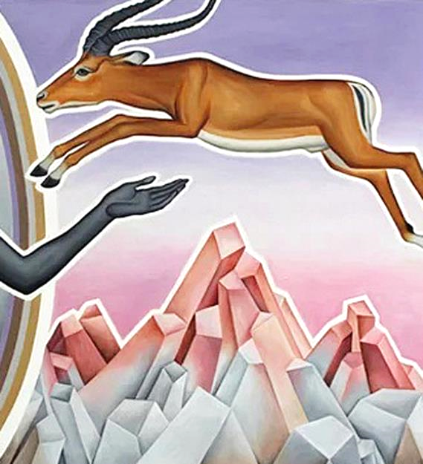
Like a Deer Leaping Mountains, detail
Peter Koenig

Slide 5
My beloved speaks and says to me: "Arise, my love, my fair one, and come away; for now the winter is past, the rain is over and gone.
Song of Solomon 2:10-11

Slide 6
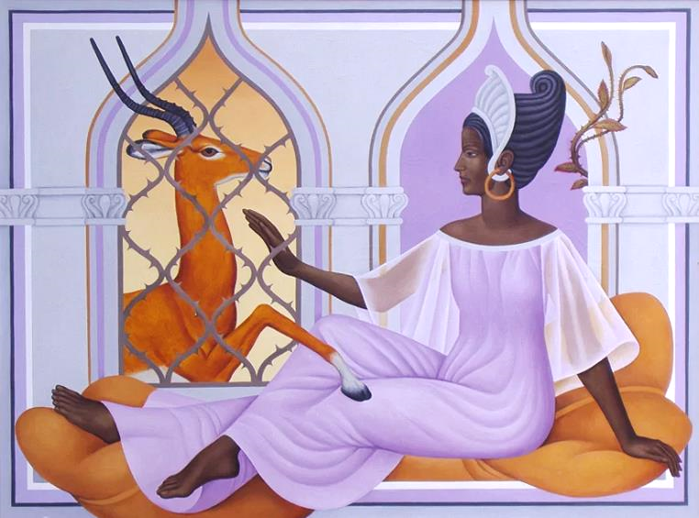
Lattice Window -- Peter Koenig

Slide 7
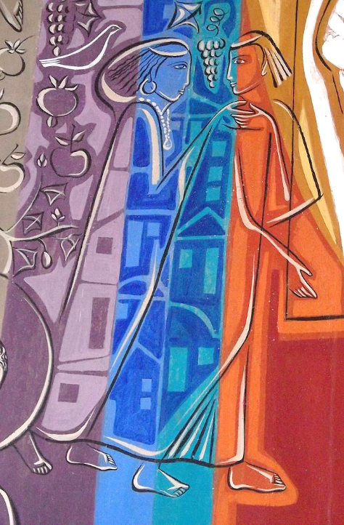
Song of Solomon
Nun's Benedictine Monastery
Claudio Pastro
Petropolis, Brazil

Slide 8
the voice of the turtledove is heard … and the vines … give forth fragrance. Arise, my love, my fair one, and come away."
Song of Solomon 2:12b, 13b

Slide 9
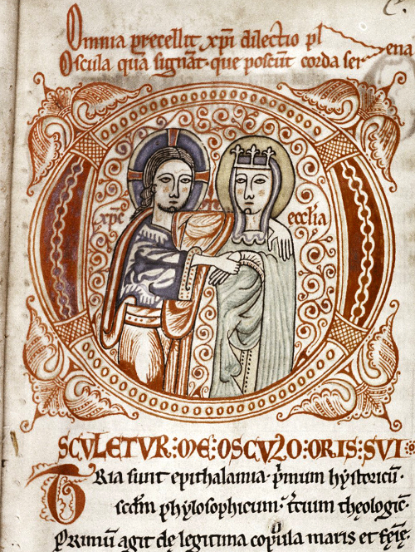
Christ and Ecclesia
Monk Thomas Commentary on Song of Solomon Kloster Eberbach Monastery, Germany

Slide 10
… keep the commandments of the LORD your God … make them known to your children and your children's children--
Deuteronomy 4:2b, 9b

Slide 11
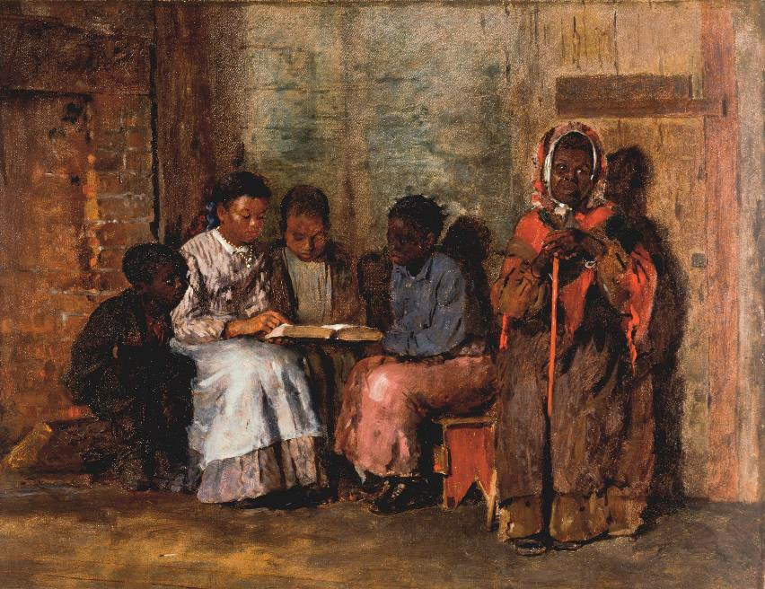
Sunday Morning -- Winslow Homer, Cincinnati Art Museum, Cincinnati, OH

Slide 12
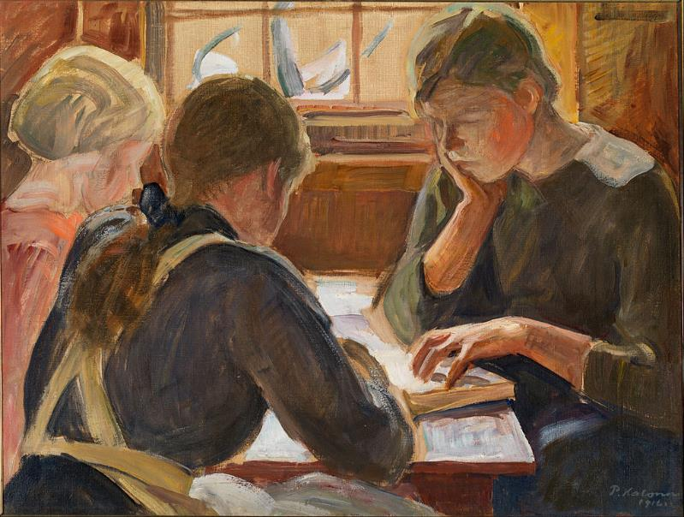
Children Reading -- Pekka Halonen, Espoo Museum of Art, Espoo, Finland

Slide 13
O LORD, who may abide in your tent? Those … who do not lend money at interest, and do not take
a bribe against the innocent.
Psalm 15:1b, 2a, 5a

Slide 14
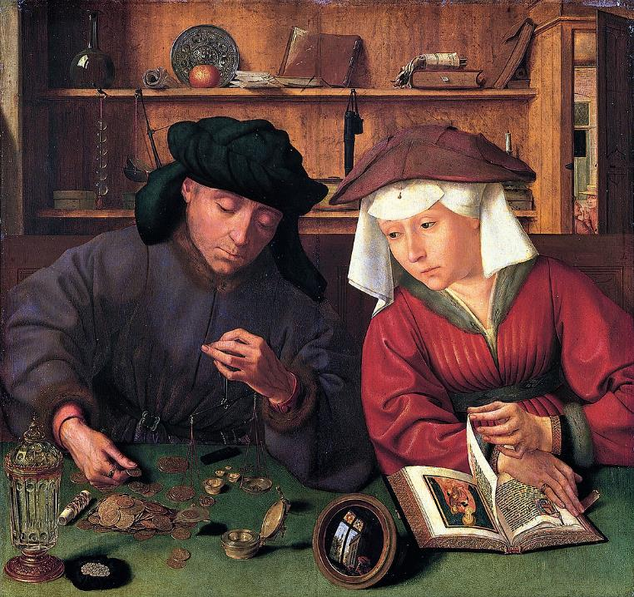
The Moneylender and his Wife
Quentin Matsys
Louvre Museum
Paris, France

Slide 15
Every generous act of giving, with every perfect gift, is from above, coming down from the Father of lights …
James 1:17a

Slide 16
Skyspace -- James Turrell, Live Oak Meeting House, Houston, TX

Slide 17
But be doers of the word, and not merely hearers who deceive themselves.
James 1:22

Slide 18
Logo of the Dorcas Care Group, AIDS Support Network -- South Africa

Slide 19
Religion that is pure and undefiled … is this: to care for orphans and widows in their distress …
James 1:27

Slide 20
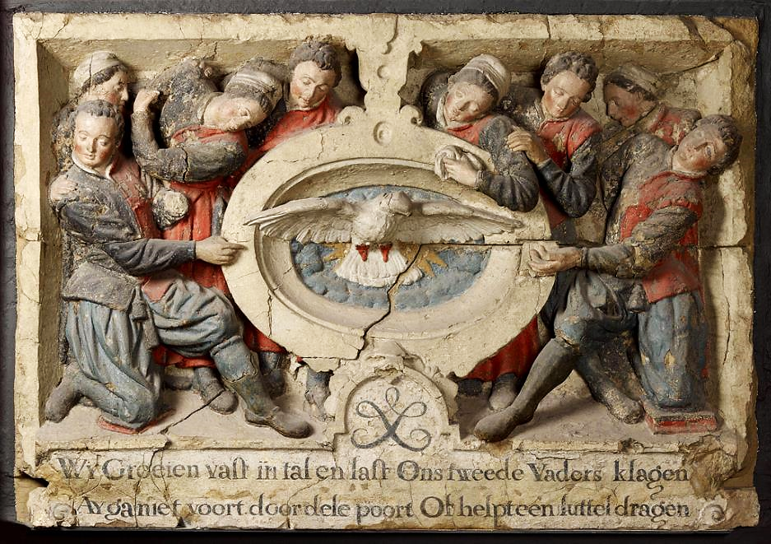
Civic Orphanage Emblem -- Amsterdams Historisch Museum, Amsterdam, Netherlands

Slide 21
So the Pharisees and the scribes asked him, "Why do your disciples not live according to the tradition of the elders, but eat with defiled hands?"
Mark 7:5

Slide 22
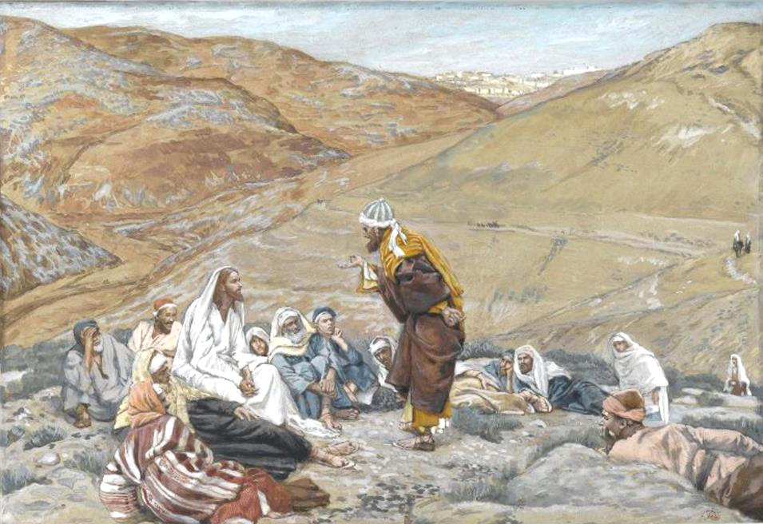
A Scribe Speaks to Jesus -- James Tissot, Brooklyn Museum, Brooklyn, NY

Slide 23
"Listen … and understand: there is nothing outside a person that by going in can defile, but the things that come out are what defile."
Mark 7:14b, 15

Slide 24
Guarding Words and Actions -- Stephen Poff

Slide 25
For it is from within, from the human heart, that evil intentions come … and they defile a person."
Mark 7:21a, 23b

Slide 26
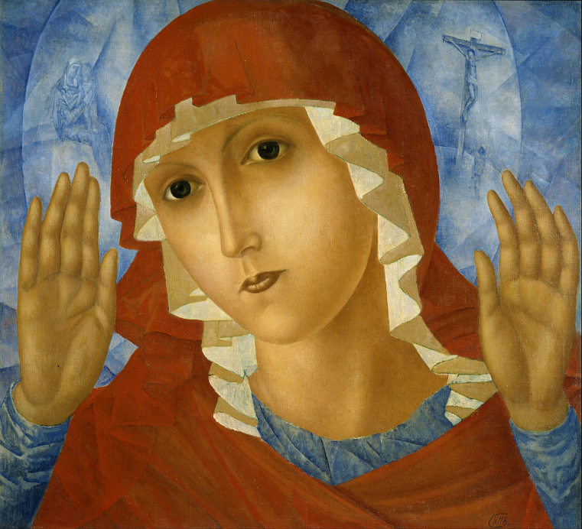
Mother of God of Tenderness Towards Evil Hearts
Kuzma Petrov-Vodkin
Russian Museum
St. Petersburg, Russia

Slide 27
Credits
New Revised Standard Version Bible, copyright 1989, Division of Christian Education of the National Council of the Churches of Christ in the United States of America. Used by permission. All rights reserved.
https://commons.wikimedia.org/wiki/File:%27Deer_Leaping_among_Flowers%27_by_Franz_Marc,_watercolor_and_pen_and_ink.jpg
https://www.pwkoenig.co.uk/
https://www.pwkoenig.co.uk/
https://commons.wikimedia.org/wiki/File:Virgin%27s_Monastery_(benedictine_nuns),_Petr%C3%B3polis,_Rio_de_Janeiro_State,_Brazil10.JPG -Eugenio Hansen, OFS
https://commons.wikimedia.org/wiki/File:KlosterEberbach_Hohenlied_Christus_und_Ecclesia.jpg
https://commons.wikimedia.org/wiki/File:Winslow_Homer_-_Sunday_Morning_in_Virginia_-_Google_Art_Project.jpg
https://commons.wikimedia.org/wiki/File:Halonen,_Pekka_-_Children_reading_-_Google_Art_Project.jpg
https://commons.wikimedia.org/wiki/File:Quentin_Massys_001.jpg
http://www.flickr.com/photos/21804434@N02/5394865139
http://www.flickr.com/photos/40843170@N02/4265934026/
http://commons.wikimedia.org/wiki/File:Bilhamer.jpeg - Joost Jansz. Bilhamer
https://commons.wikimedia.org/wiki/File:Brooklyn_Museum_-_The_Scribe_Stood_to_Tempt_Jesus_(Le_scribe_se_leva_pour_tenter_J%C3%A9sus)_-_James_Tissot_-_overall.jpg
http://www.flickr.com/photos/stephenpoff/3530640841/
https://commons.wikimedia.org/wiki/File:Kuzma_Petrov-Vodkin_-_The_Mother_of_God_of_Tenderness_Towards_Evil_Hearts_-_Google_Art_Project.jpg
Additional descriptions can be found at the Art in the Christian Tradition image library, a service of the Vanderbilt Divinity Library, http://diglib.library.vanderbilt.edu/. All images available via Creative Commons 3.0 License.

